Slide 1
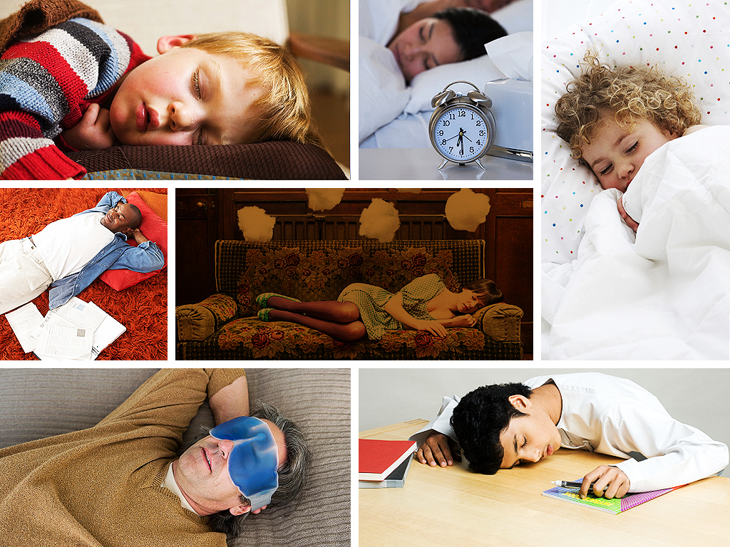


Automatic sleep stage classification using Deep Transfer Learning
Presented By: Rumana Sultana

Slide 2
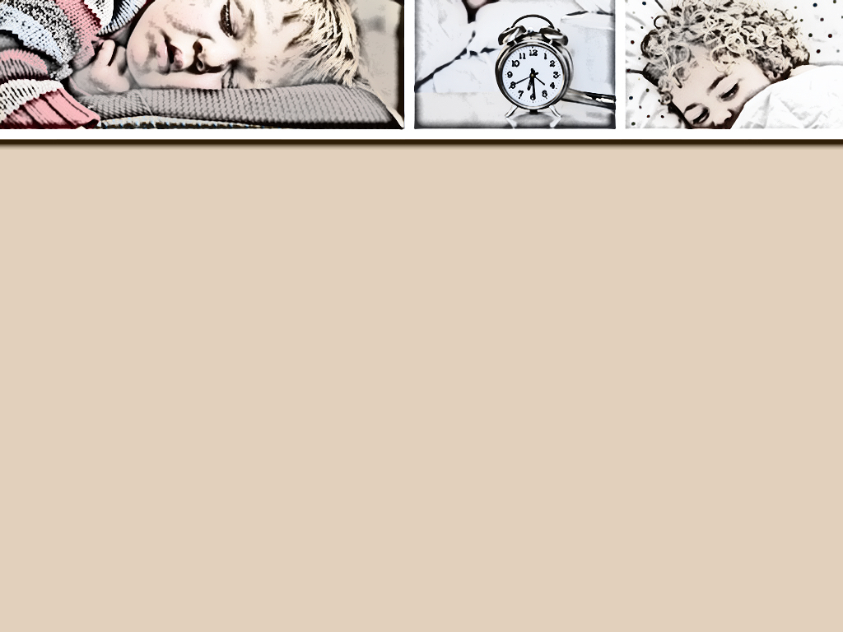

Introduction
Problem Statement and Background
Analysis and Exploration of Dataset
Previous Research Works
Methodology and Implementation
Testing and Result Analysis
Challenges and Future plan
Conclusion
Git Link: https://github.com/RumanaCU/Sleep-Staging

Slide 3
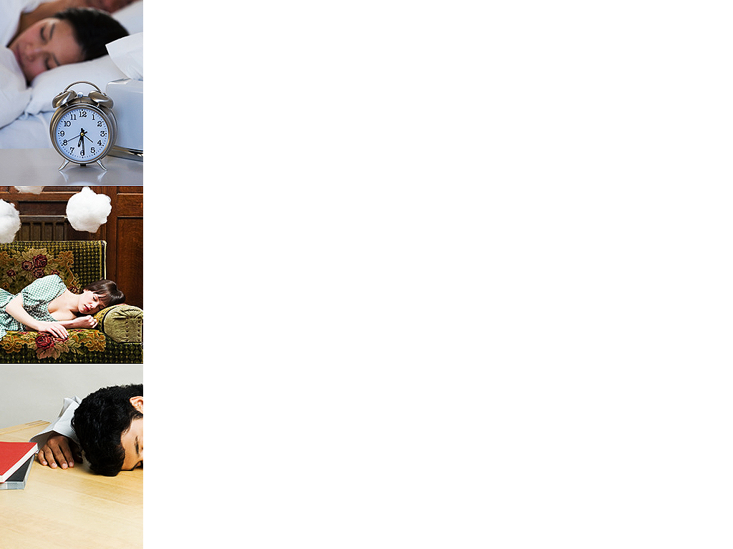
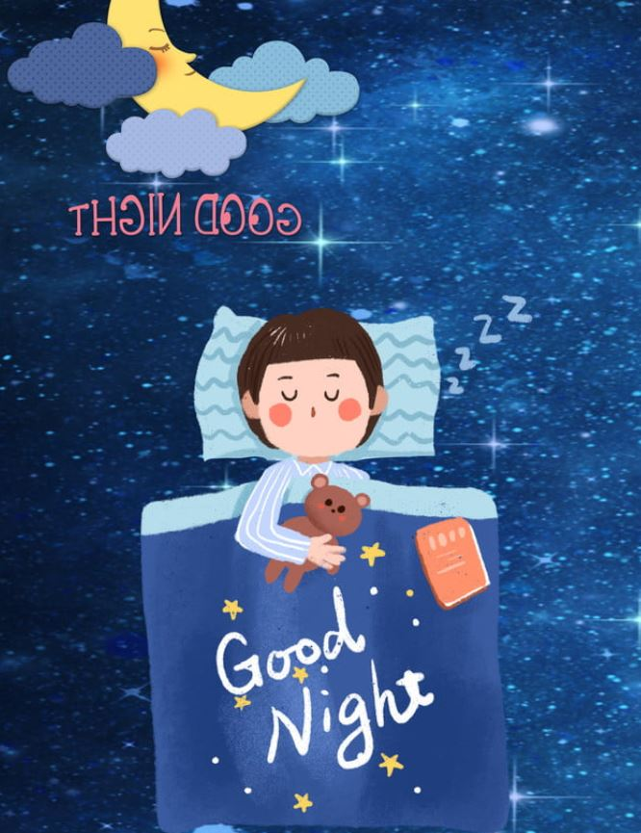
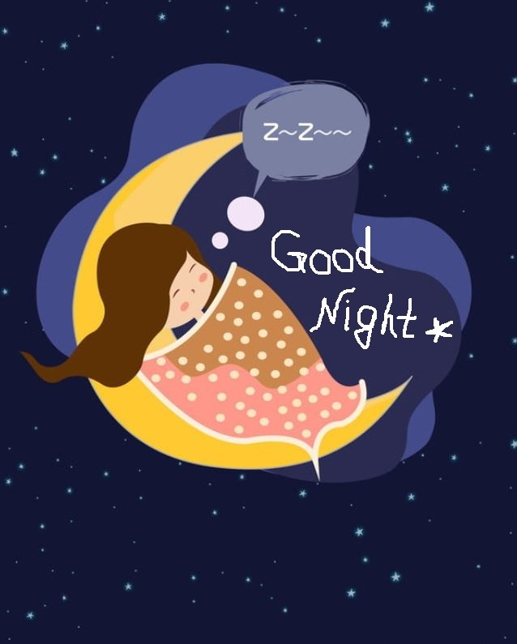
Problem Statement and Background Why Sleep Stage Classification?
Depression is a long-term disorder of human life.
Hundreds of thousands of people are suffering from sleep disorder caused by depression
That can consequence to heart attack and even death.
Current pandemic situation increased this situation.
There is a need to improve human lifestyle and healthiness
It has significant importance in clinical science to diagnose the symptoms and diseases

Slide 4
Problem Statement and Background Why does data science solution need?
Labeling of sleep stages from polysomnography (PSD) is highly time consuming with clinicians and cost involvement.
Currently machine and deep learning techniques are widely using for every sectors, but big dataset is needed to achieve expected performance.
Home based sleep monitoring edge devices is not reliable due to data insufficiency.
Edge devices are dependable to cloud server for data driven decision making.
Latency and failure of service is an overhead.
Need to develop a data-efficient model for sleep staging from raw data for edge devices that can perform overall accuracy and macro F1 score above 87%-83.

Slide 5
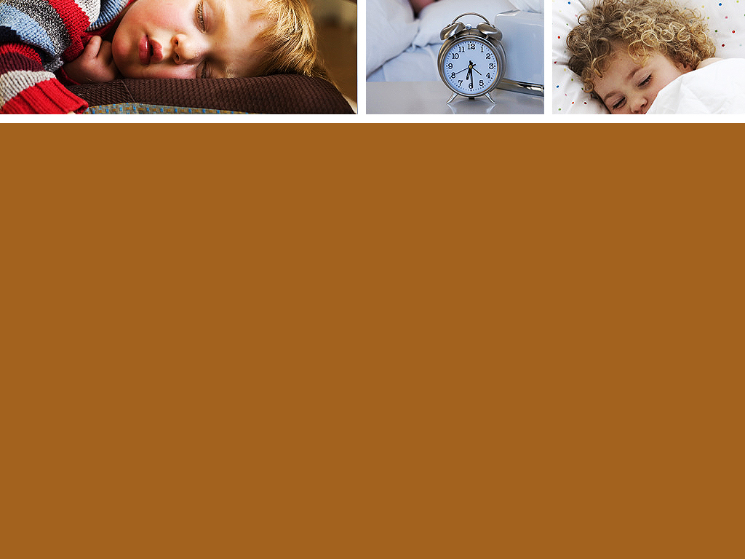
Previous Research works
DeepSleepNet [3] – A sleep stage scoring model based on single channel EEG (F4-EOG (left), Fpz-Cz, and Pz-Oz) from two publicly available sleep dataset MASS and Sleep-EDF. A combine model of representation learning and sequence residual learning. The overall accuracy and macro F1 score achieved: MASS: 86.2%-81.7, Sleep-EDF: 82.0%-76.9.
The Survey paper [4] described the applications scenario for edge intelligence and intelligent edge, practical implementation methods and enabling technologies and future challenges of edge computing.
The Survey paper [5] described about model compression techniques for DNN models including parameter pruning and quantization, low-rank factorization, transferred/compact convolutional filters, and knowledge distillation.
The research paper [6] initiated a model for automatic sleep staging using deep transfer learning. They used MASS sleep database for source domain and the Sleep-EDF Expanded database, and the Surrey-cEEGrid database as target domain. Their proposed DTL model outperformed over all previous work including accuracies 84:3% and 85:2% for the target domain database.

Slide 6
Analysis and Exploration of Dataset
Sleep-EDF Expanded Database- 197 whole-night Polysomnographic sleep recordings, including EEG, EOG, Chin EMG, and event markers of around 20 subjects.
Downloaded from-https://www.physionet.org/static/published-projects/sleep-edfx/sleep-edf-database-expanded-1.0.0.zip.
Data and Annotation Files:
*PSG.edf files- whole night recordings of EEG, EOG, submental chin EMG and even marker.
SC*PSG.edf- contain oro-nasal respiration and rectal body temperature.
*Hypnogram.edf- annotation of sleep pattern correspond to PSGs consist of sleep stages W, R,1,2,3,4,M and ?(not scored)
Unrecorded signals removed from ST*PSG.edf
Stages: W=wakefulness, R- rapid eye movement, N1-light sleep,N2-deeper sleep, N3&4-deep sleep.
MASS Database- whole night recordings of 97 males and 103 female’s hospital‐based sleep laboratories data (a total of 200 subjects) with an age ranged 18-76 years.

Slide 7
Analysis and Exploration of Dataset
Sleep Cassette Study and Data:
153 SC*files of healthy Caucasians aged 25-101, with no medication.
Variables: Files are named in the form of SC4ssNE0-PSG.edf.
Where, ss=subject number, N=night.
Missing Values: The first night of subjects 36 and 52, and the second night of subject 13, were lost due to failing cassette or laserdisk.
EEG and EOG signals were sampled at 100Hz.
EMG signal was high-pass filtered, rectified and low-pass filtered and resulted EMG, expressed in uV(root-mean=square) was sampled at 1 HZ.
Oro-nasal airflow, body temperature and event marker sampled at 1 HZ.
Sleep Telemetry Study and Data:
44 ST*files of temazepam effects on sleep in 22 Caucasians males and females, difficulty with falling asleep.
Variables: Files are named in the form of ST7ssNJ0-PSG.edf
where, ss=subject number, N=night
EOG, EMG, and EEG signals sampled at 100Hz.

Slide 8
Methodology and Implementation
Train a DeepSleepNet using DNN on source domain.
Finetune source model into a small sub-model on target domain.
Filter data from user-end with a threshold.
If confidence below threshold, data sent to source domain.
Technology
Deep Transfer Learning
DL models are data hungry. Training is very expensive in resource and time.
With DTL, part of one big model can use to predict another small model.
Able to perform with lack of data, reduce training speed, and increase efficient use of resources.

Slide 9
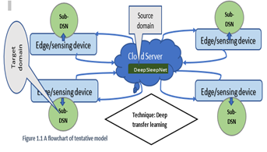
Methodology and Implementation (Cont.)
Figure 1: Flowchart

Slide 10
Methodology and Implementation(cont.)
PLATFORMS (could be choose as per necessity)
MATLAB (for data preparation)
Python3, TensorFlow 2 (for network training and evaluation)
NumPy, SciPy, Sklearn, H5py.
REASONS OF CHOOSING PLATFORMS:
MATLAB has user-friendly EEGLAB toolbox to process the EEG data with applying necessary high pass and low pass filter.
Python3 and TensorFlow 2 is very enriched with machine and deep learning libraries.
NumPy makes easy complex machine and deep learning numerical operations with large dataset.
SciPy contains different modules for optimization, linear algebra, integration and statistics that is very helpful for data analysis.
Scikit-learn, a machine learning library for Python has various algorithms like support vector machine, random forests, and k-neighbours, and it supports Python numerical and scientific libraries like NumPy and SciPy.
H5py is helpful for viewing datasets of different formats in a tabular way or as an image.

Slide 11
Testing and Result Analysis

Slide 12
Testing and Result Analysis (Cont…)

Slide 13
Testing and Result Analysis (Cont…)

Slide 14
Testing and Result Analysis (Cont…)

Slide 15
Testing and Result Analysis (Cont…)

Slide 16
Testing and Result Analysis (Cont…)

Slide 17
Challenges and Future plan

Slide 18
Challenges and Future plan
(Cont…)

Slide 19
Conclusion
Ensure sound sleep, ensure healthy life.
Enrich sleep analysis with mobile computing.
Increase reliable home-based sleep monitoring.

Slide 20
Thank you
Questions
???

Slide 21
References
[1] https://poweredtemplate.com/05036/0/index.html
[2] https://pngtree.com/free-backgrounds-photos/sleeping
[3] Supratak, A., Dong, H., Wu, C., & Guo, Y. (2017). DeepSleepNet: A model for automatic sleep stage scoring based on raw single-channel EEG. IEEE Transactions on Neural Systems and Rehabilitation Engineering, 25(11), 1998-2008.
[4] Wang, X., Han, Y., Leung, V. C., Niyato, D., Yan, X., & Chen, X. (2020). Convergence of edge computing and deep learning: A comprehensive survey. IEEE Communications Surveys & Tutorials, 22(2), 869-904.
[5] Cheng, Y., Wang, D., Zhou, P., & Zhang, T. (2017). A survey of model compression and acceleration for deep neural networks. arXiv preprint arXiv:1710.09282.
[6] Phan, H., Chén, O. Y., Koch, P., Lu, Z., McLoughlin, I., Mertins, A., & De Vos, M. (2020). Towards more accurate automatic sleep staging via deep transfer learning. IEEE Transactions on Biomedical Engineering.
[7] The sleep-EDF database download link, https://www.physionet.org/static/published-projects/sleep-edfx/sleep-edf-database-expanded-1.0.0.zip.Y. Yorozu, M. Hirano, K. Oka, and Y. Tagawa, “Electron spectroscopy studies on magneto-optical media and plastic substrate interface,” IEEE Transl. J. Magn. Japan, vol. 2, pp. 740–741, August 1987 [Digests 9th Annual Conf. Magnetics Japan, p. 301,1982].

